Slide 1
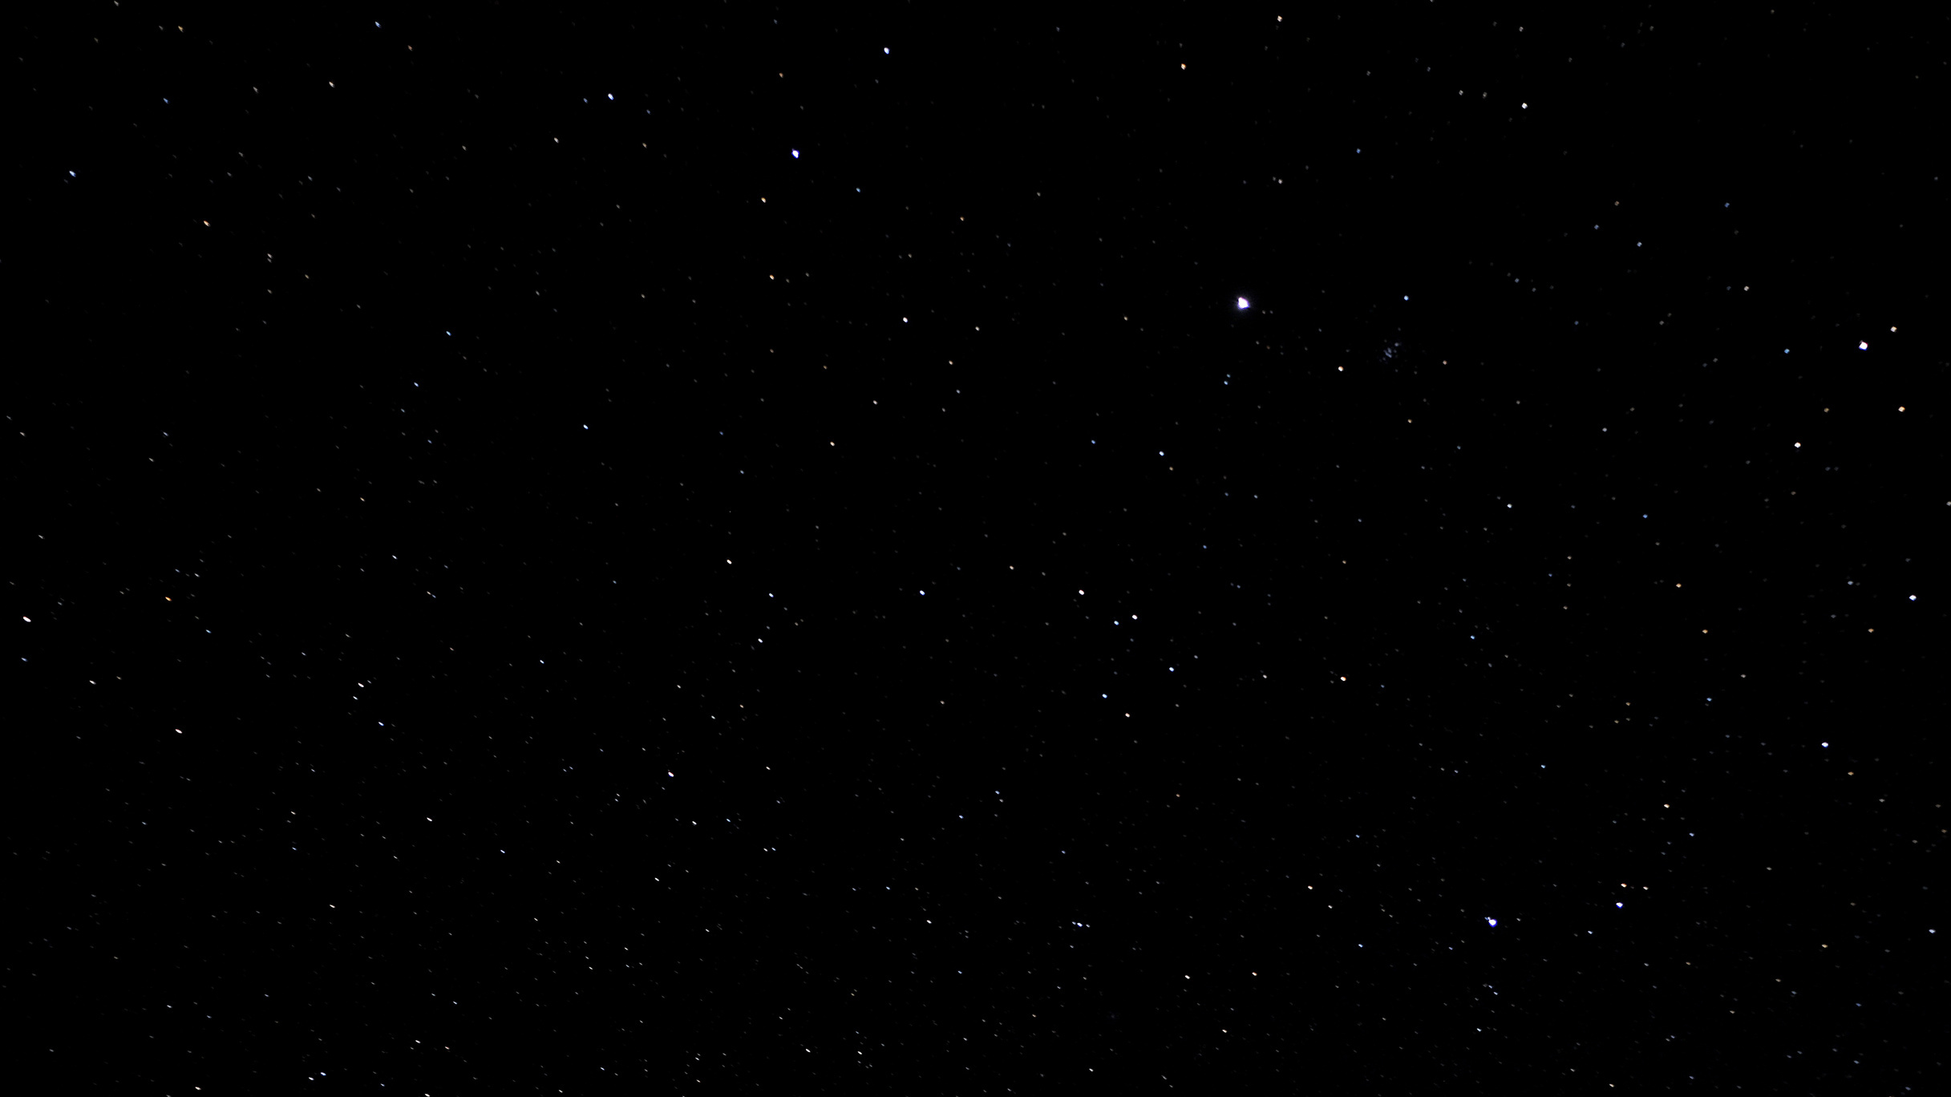

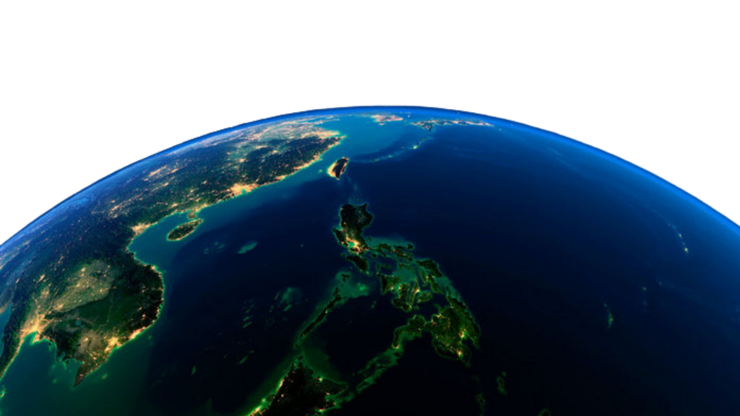
A PRESENTATION BY PROJECT GAIA
CLIMATE CHANGE IN THE PHILIPPINES THROUGH THE YEARS

Slide 2



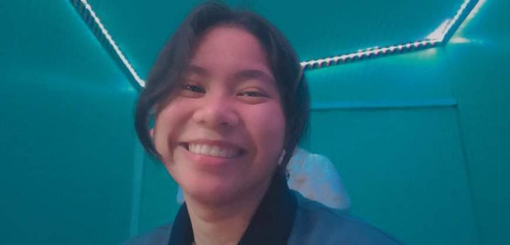
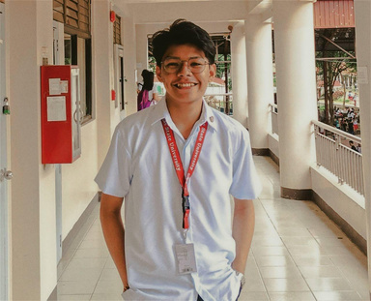
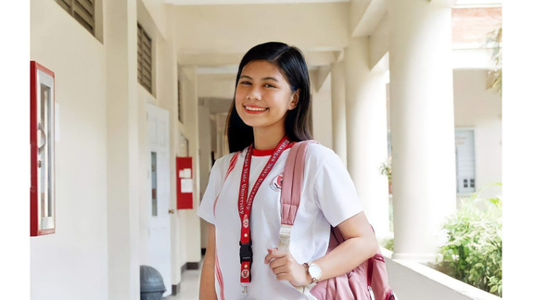
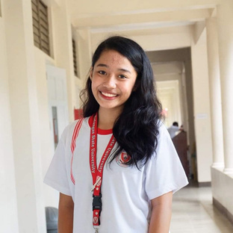
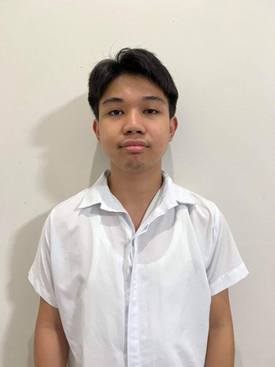
PROJECT GAIA
TEAM MEMBERS
ELEDA, LOUISSE LAINE
JAVIER,
MARJORIE
OCAMPO,
EDBERT
SALAPARE,
KIAN FRANCIS
TATLONGHARI,
ANA KARL

Slide 3
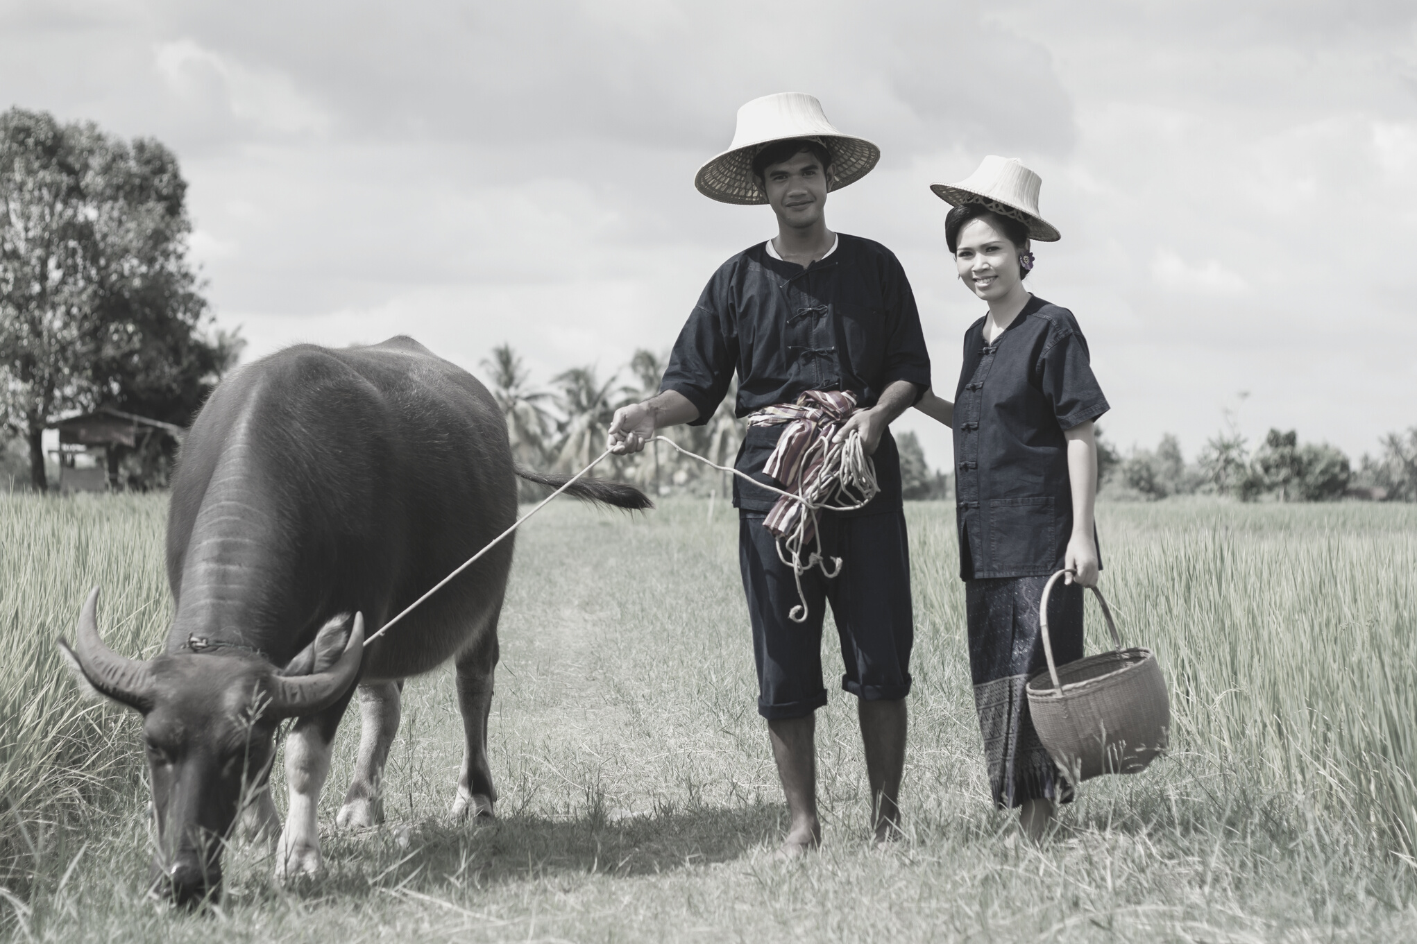

LET'S MEET
MANG SAMUEL & ALING NINA
Mang Samuel and Aling Nina are both rice farmers from the province, while planting rice they talk about how way back in the old time the temperature during the dry season is not that hot but now they notice that as years pass by when the dry season is coming, their income deflates because the heat makes their field dry. They were both so worried about what will happen in the next years that will come if the temperature keeps on rising.

Slide 4
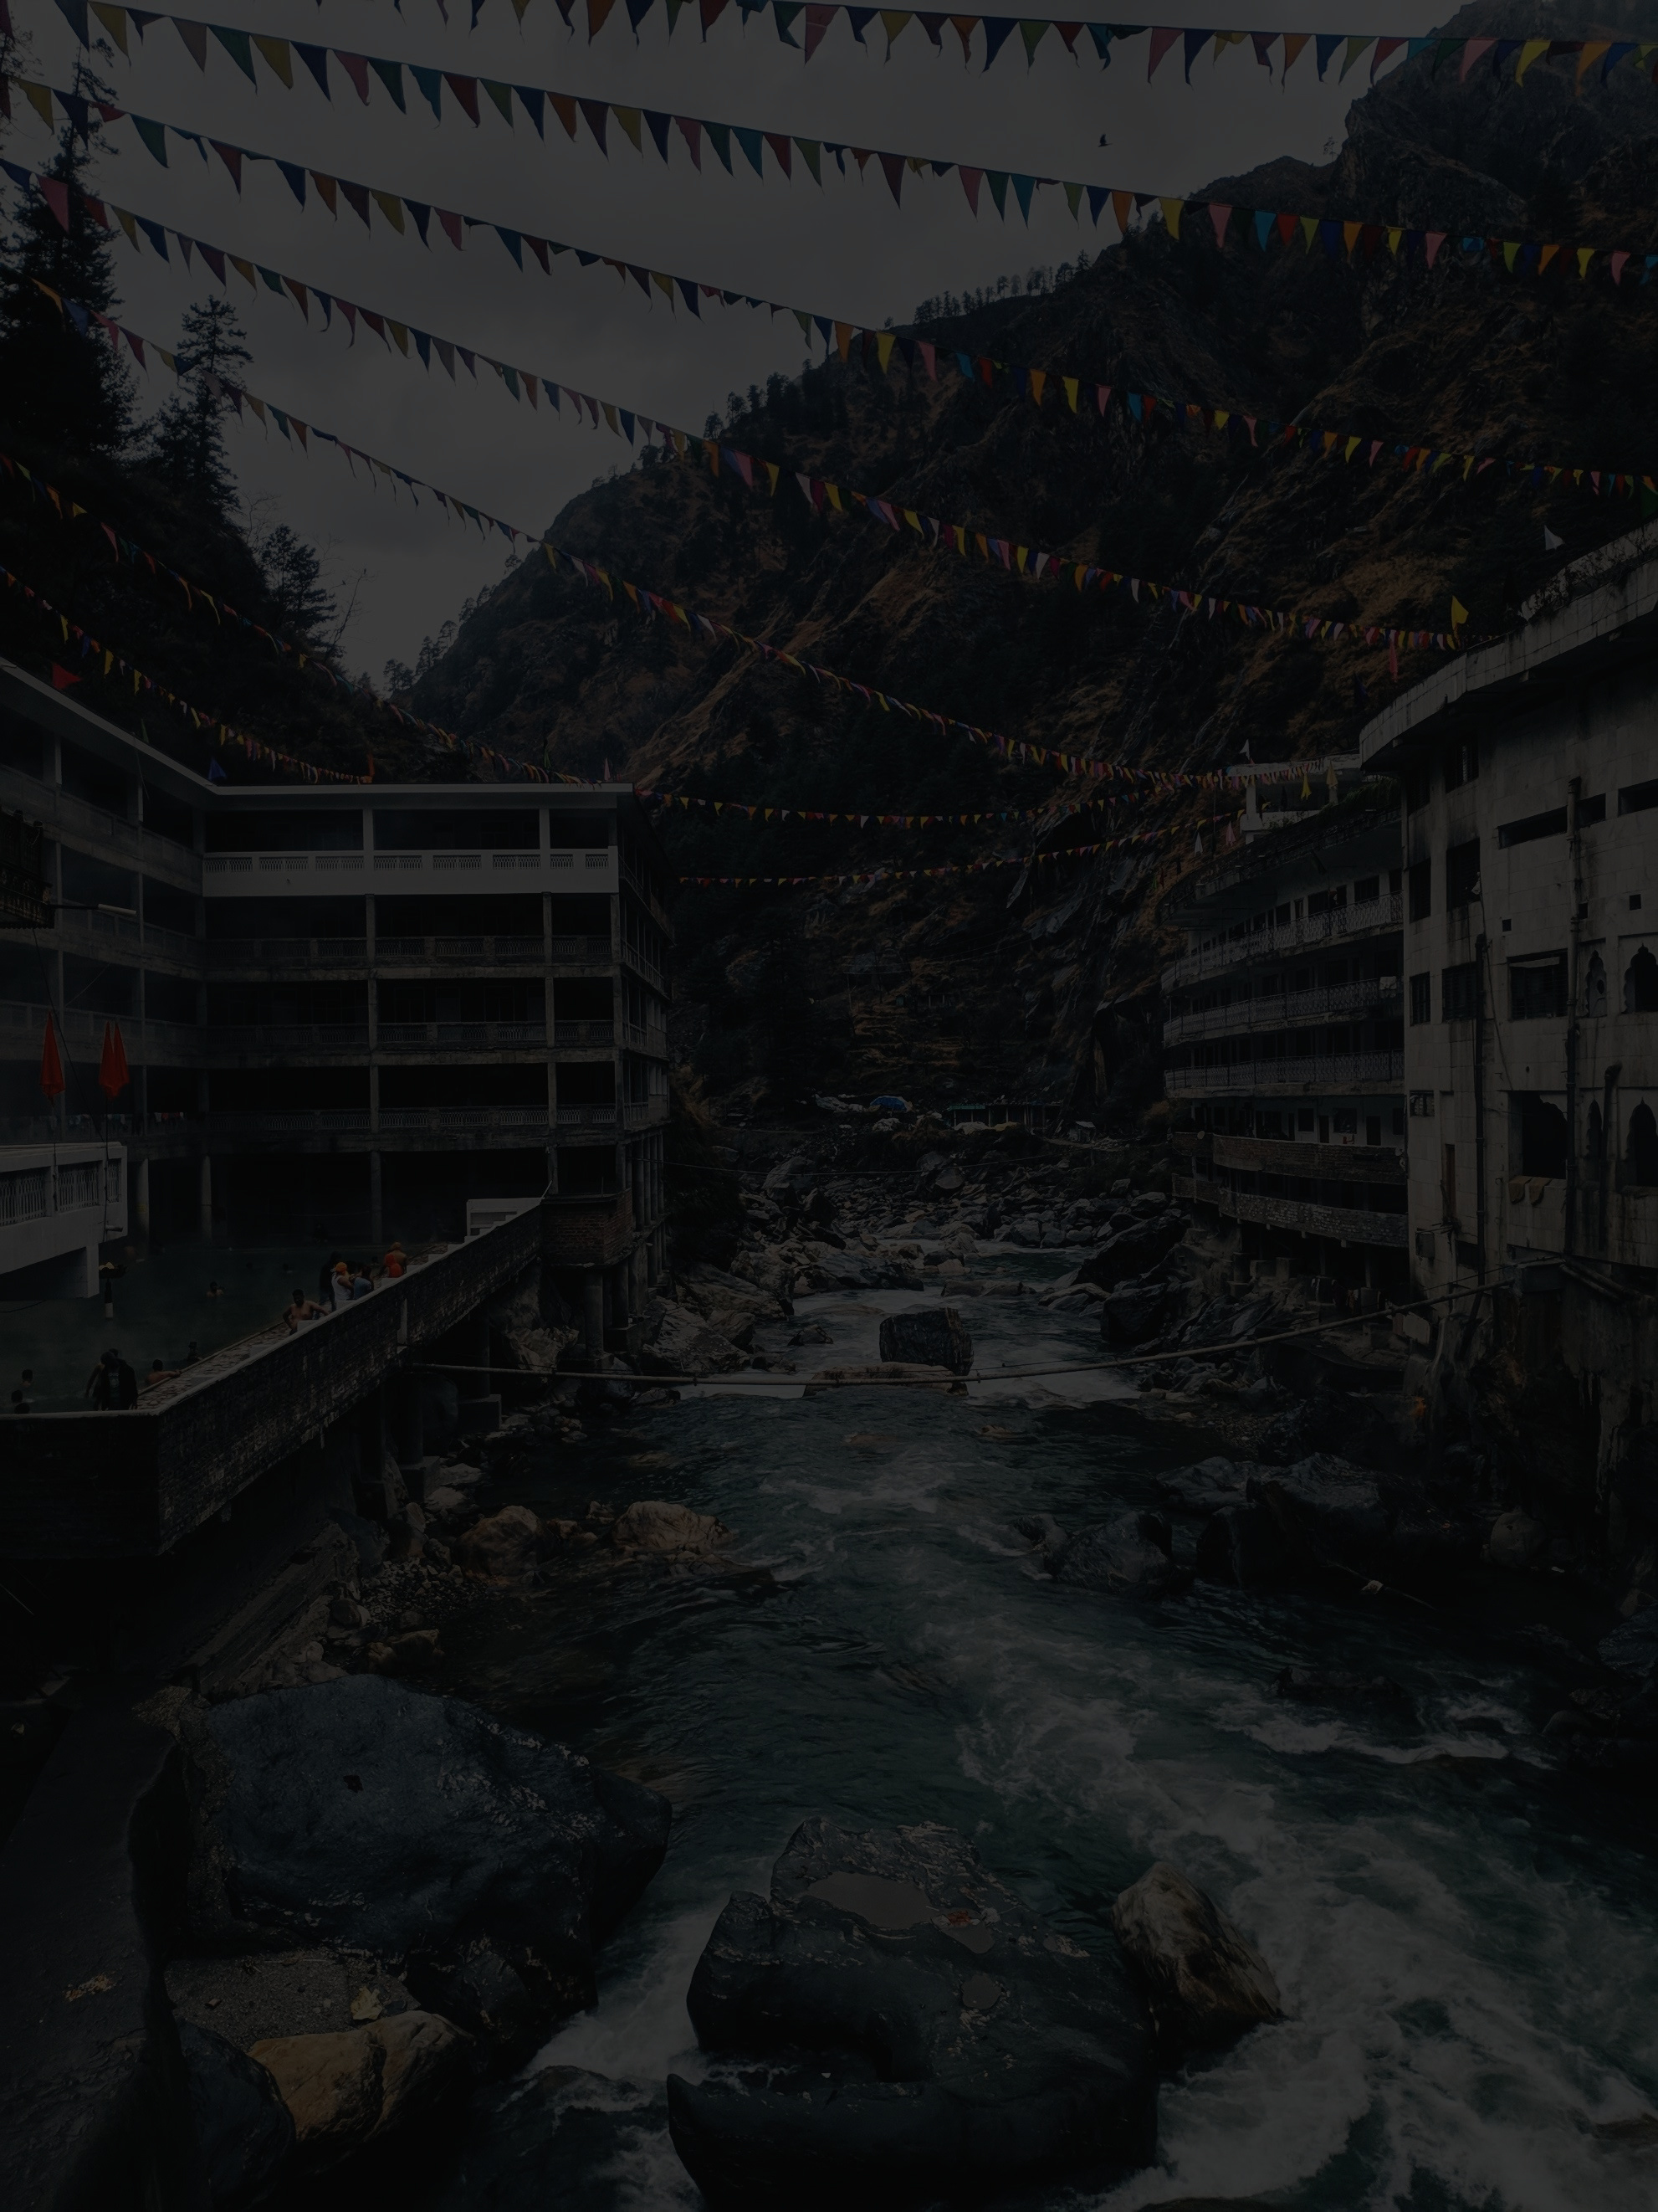
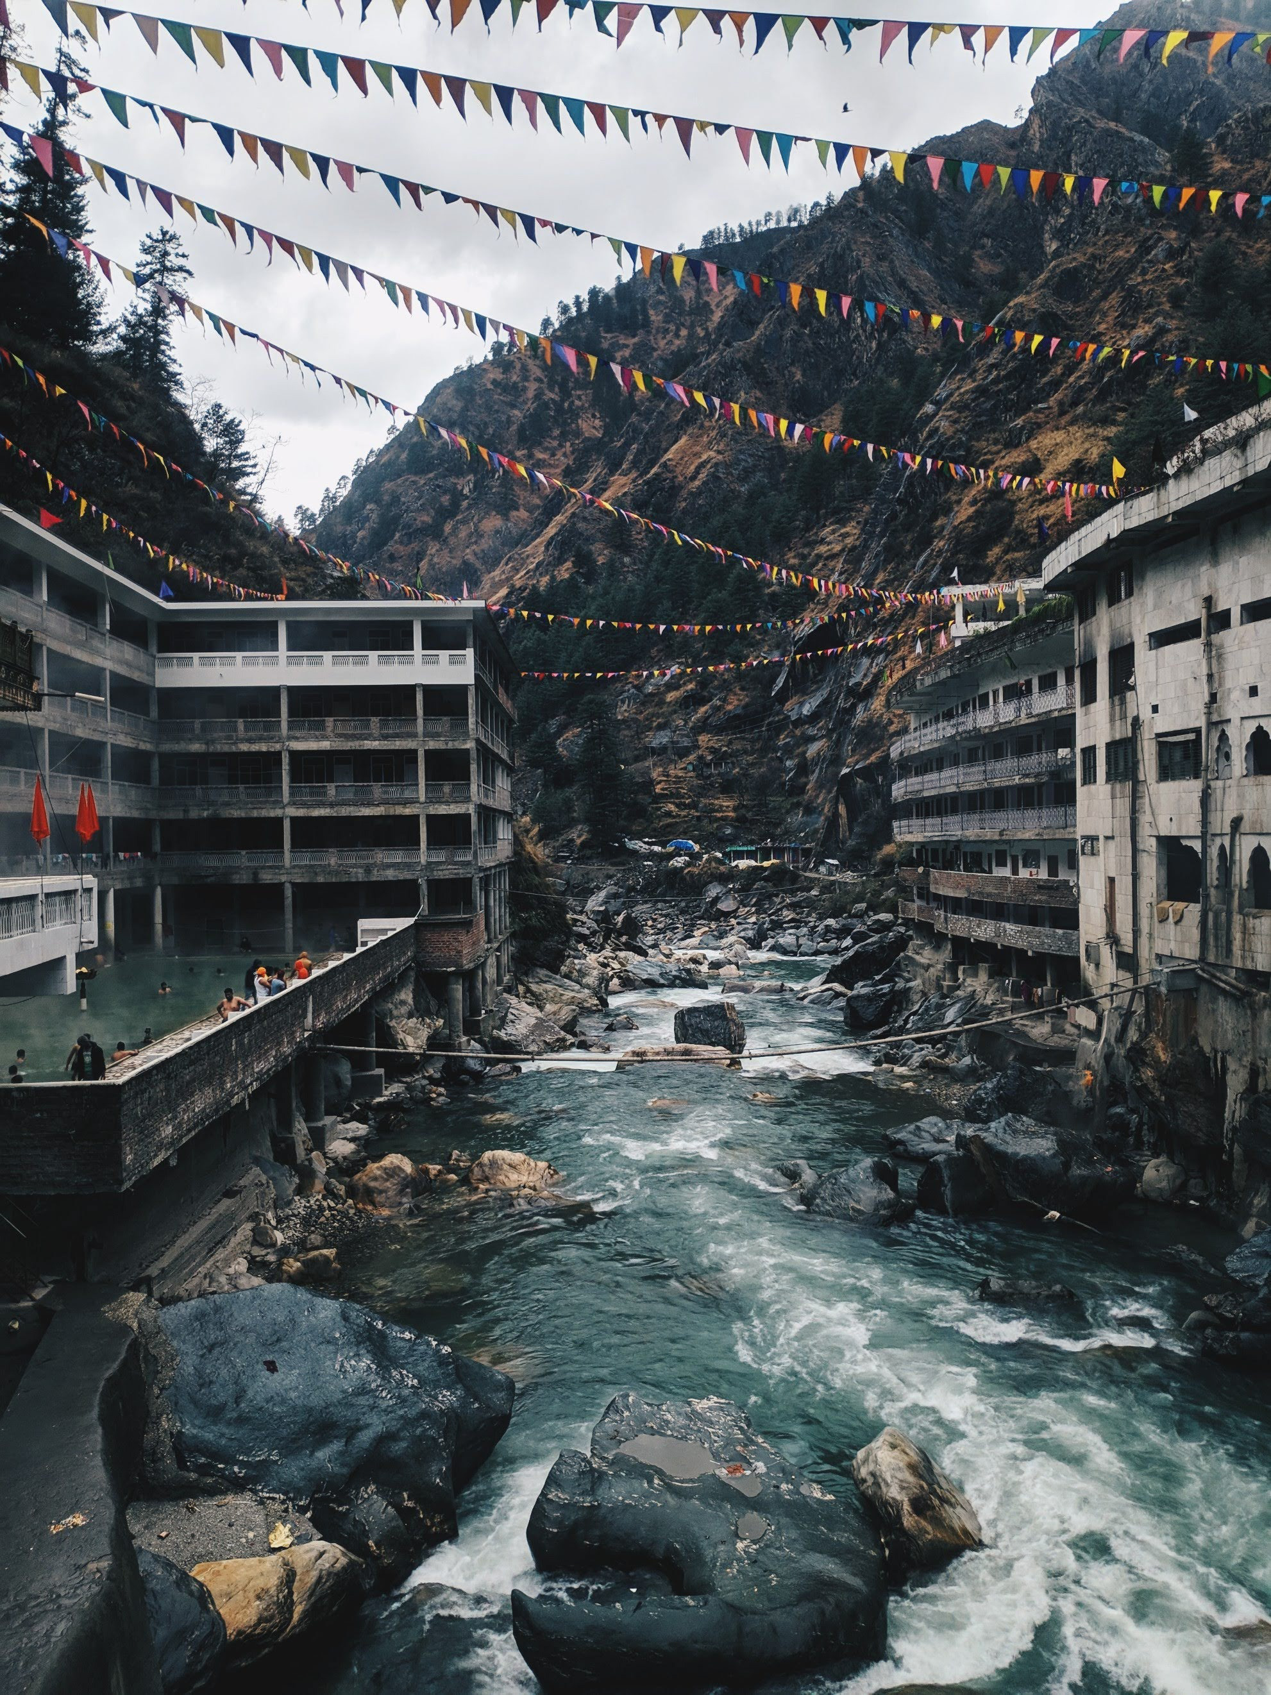
INTRODUCTION
1
OBJECTIVES
PROBLEM STATEMENT

Slide 5
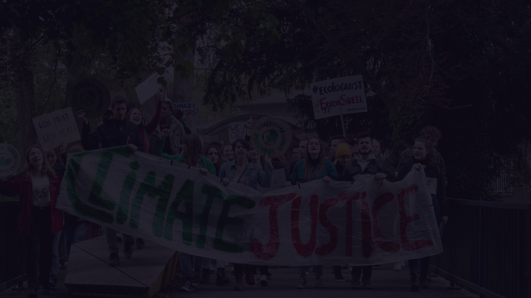


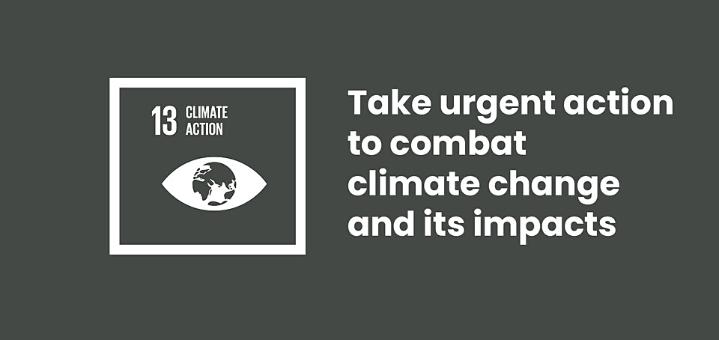



OBJECTIVES
To examine the past climate data in the Philippines
To advocate for Filipino people to take climate action for a more sustainable country

Slide 6
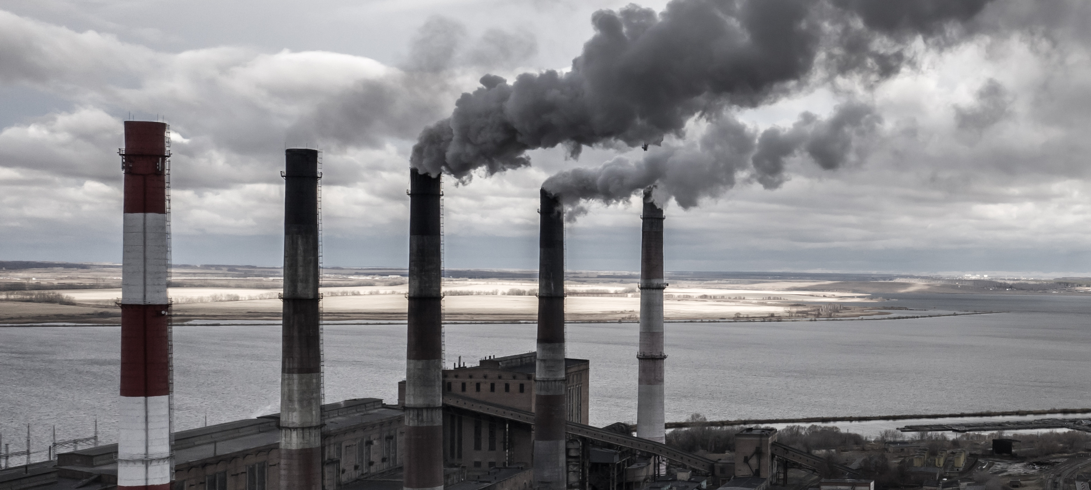
PROBLEM STATEMENT
HUMAN ACTIVITIES
are altering the composition of our atmosphere

Slide 7
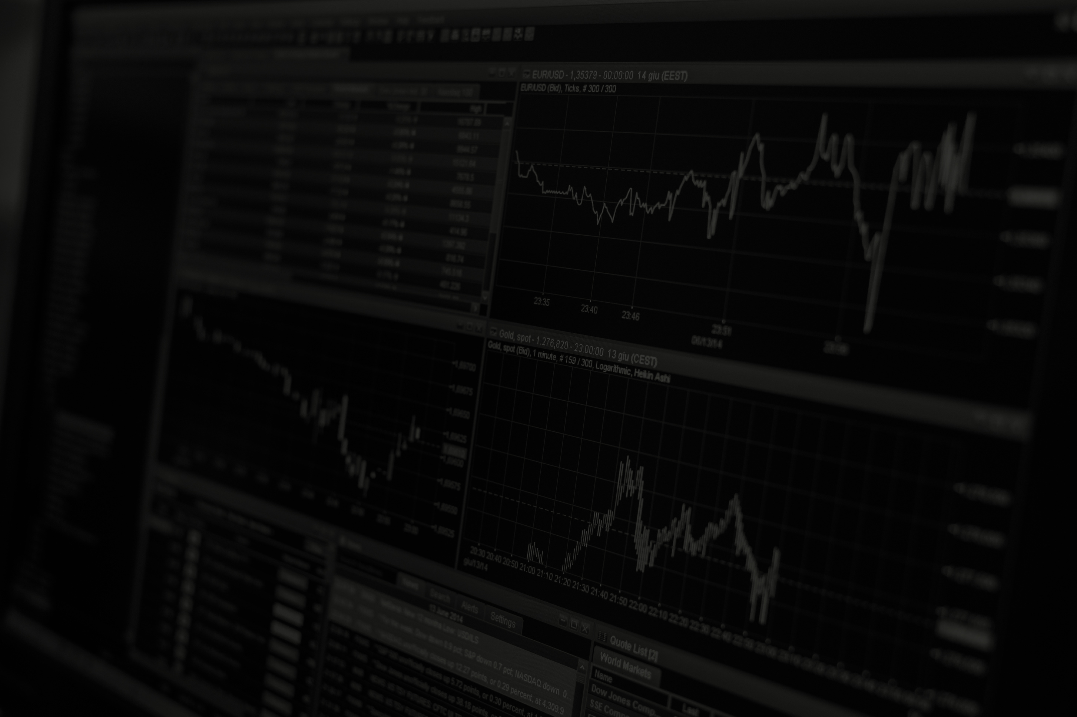
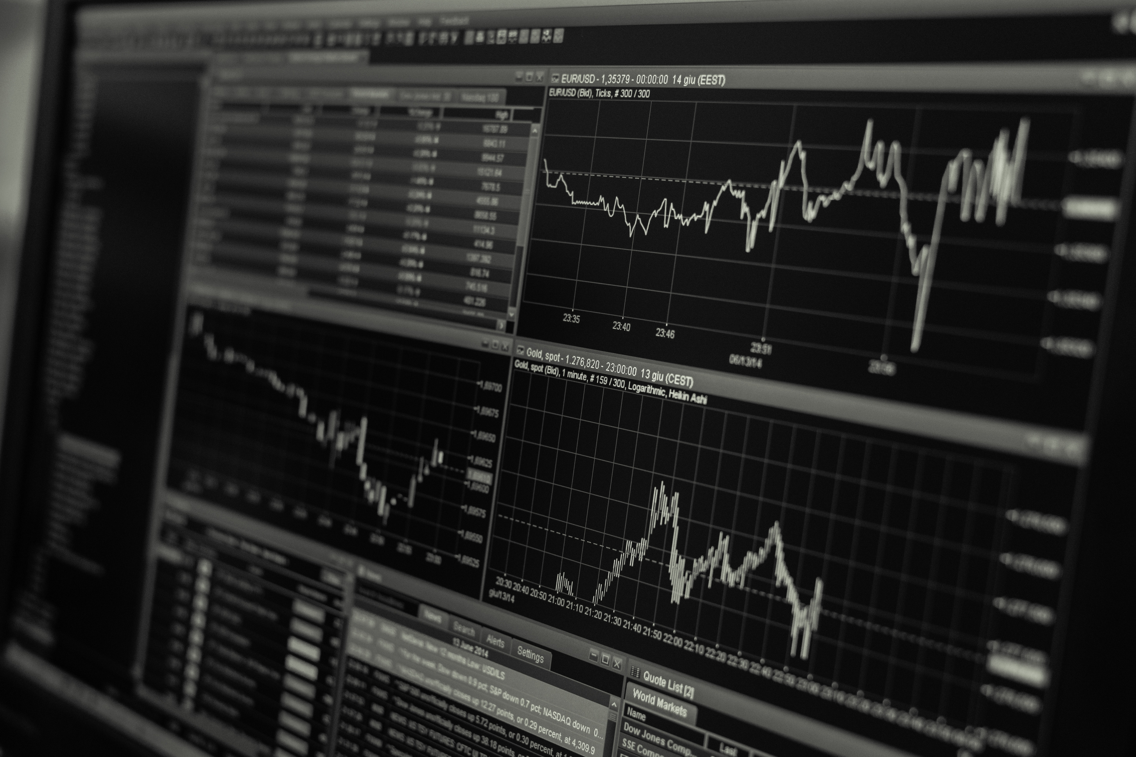
DISCUSSION
2
VISUALIZATION

Slide 8
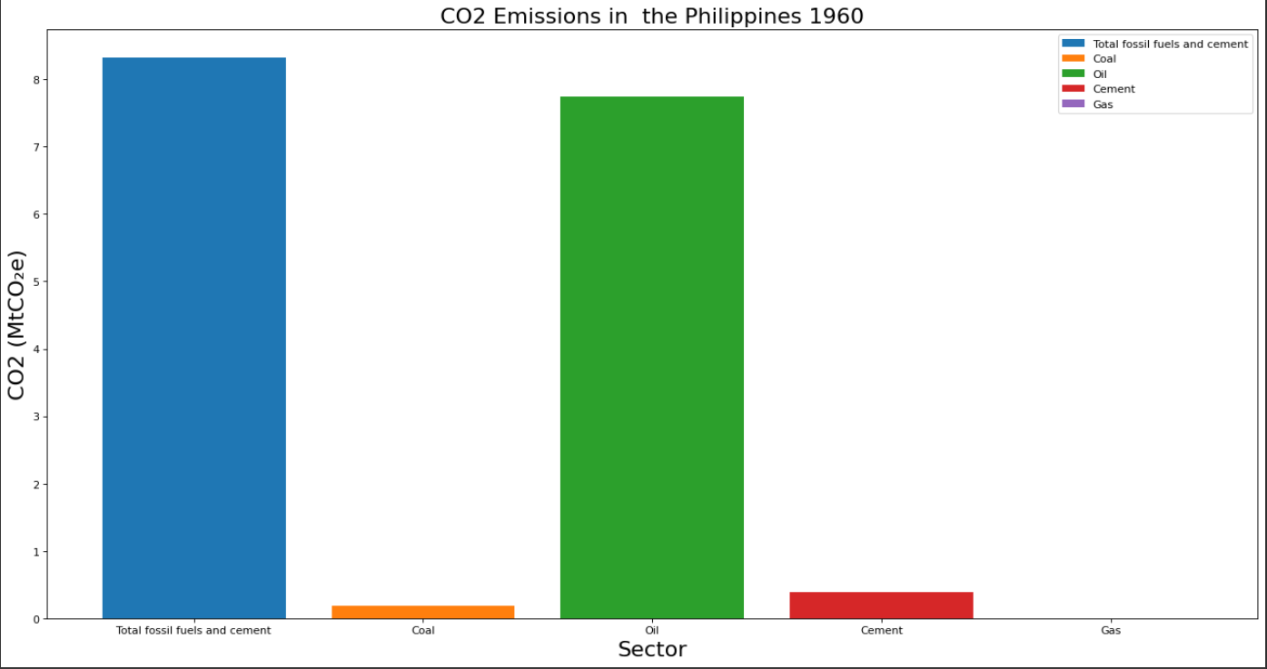
1960
CO2 Emissions in the Philippines

Slide 9
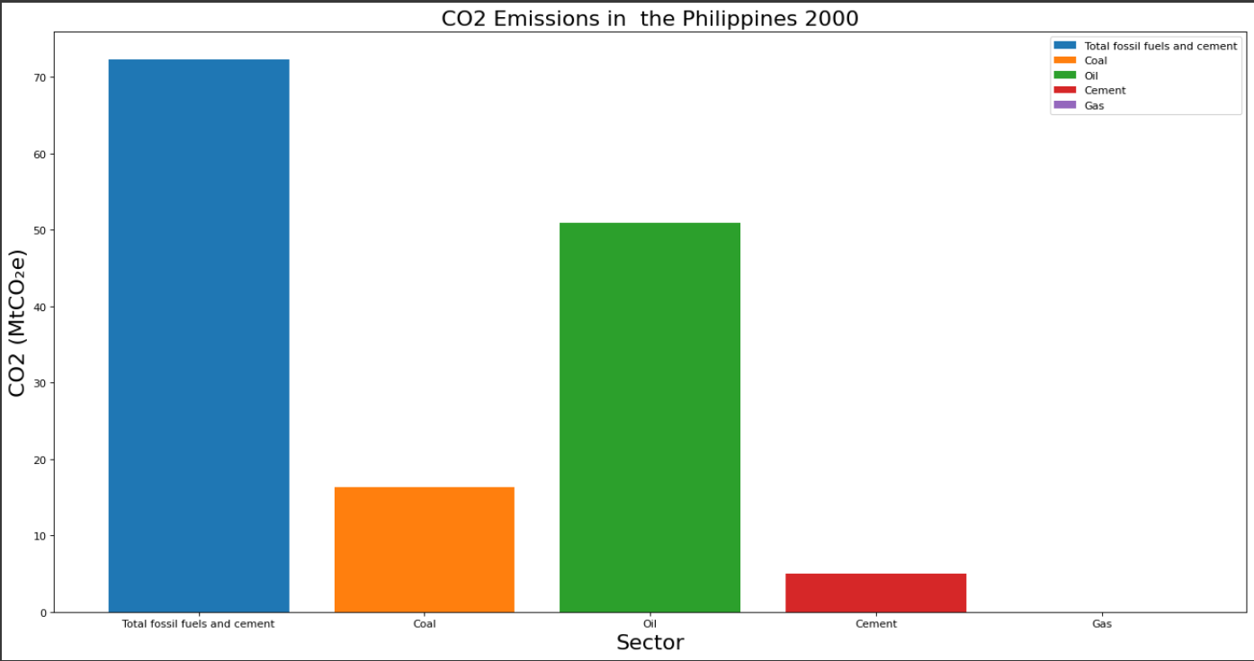
2000
CO2 Emissions in the Philippines

Slide 10
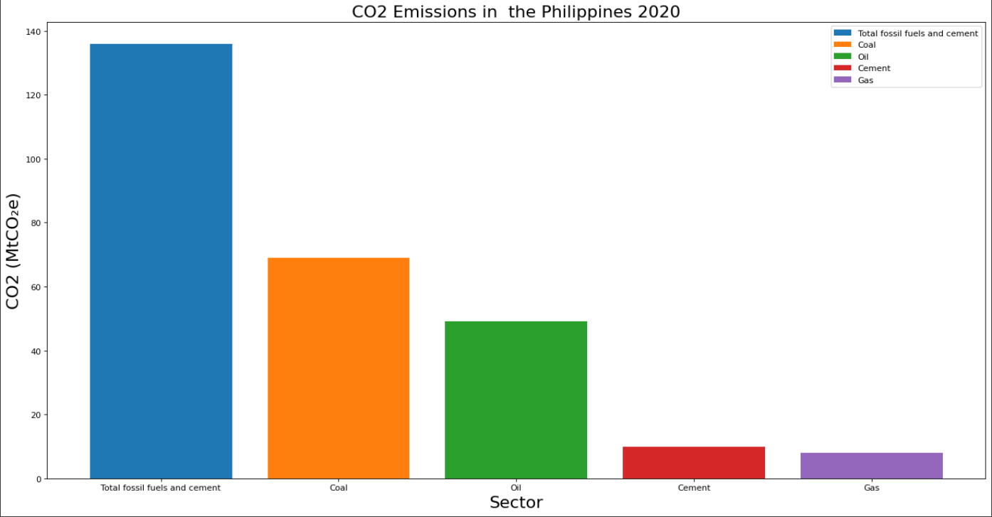
2020
CO2 Emissions in the Philippines

Slide 11
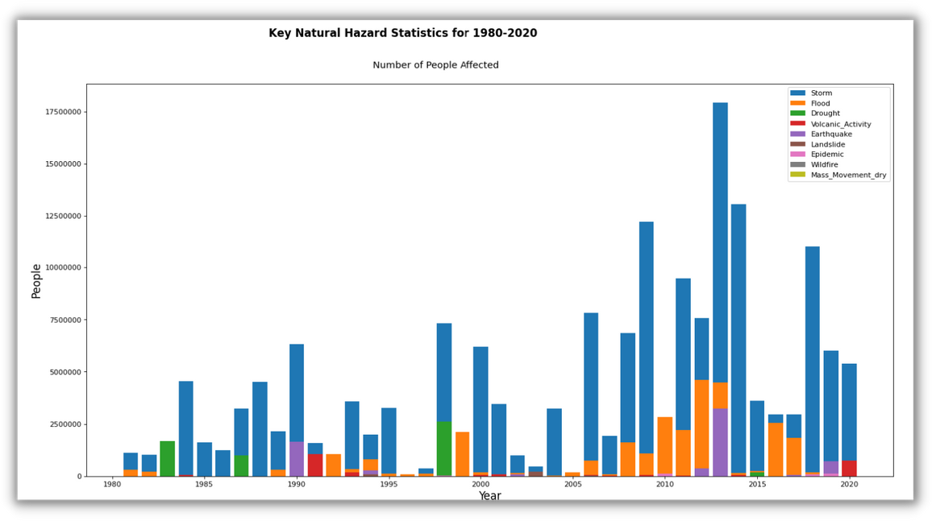
Key Natural Hazard Statistics for 1980 - 2020

Slide 12
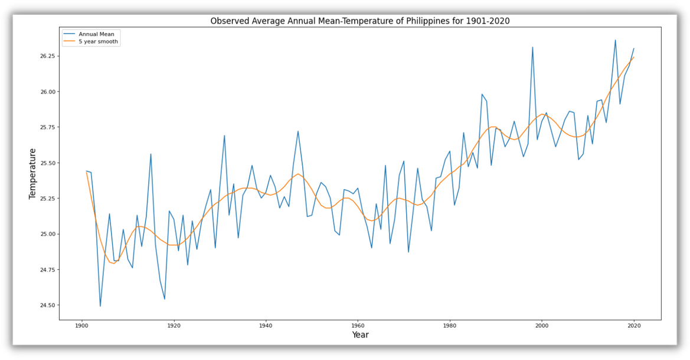
Observed Average Annual Mean-Temperature
of Philippines for 1901 - 2020

Slide 13
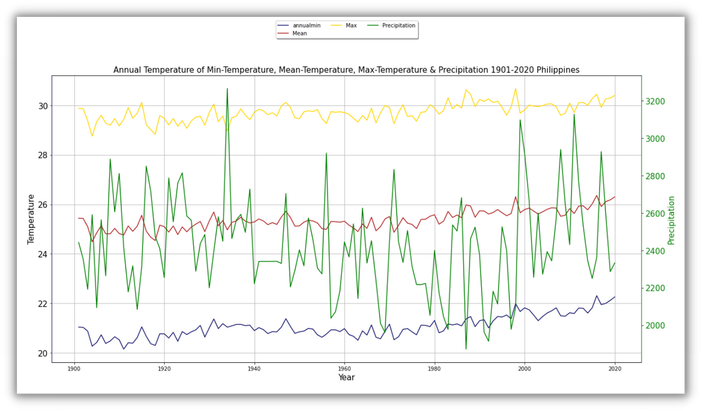
Annual Temperature of Min-Temperature, Max-Temperature & Precipitation 1901 - 2020

Slide 14


SOLUTION
3
Expected Output

Slide 15

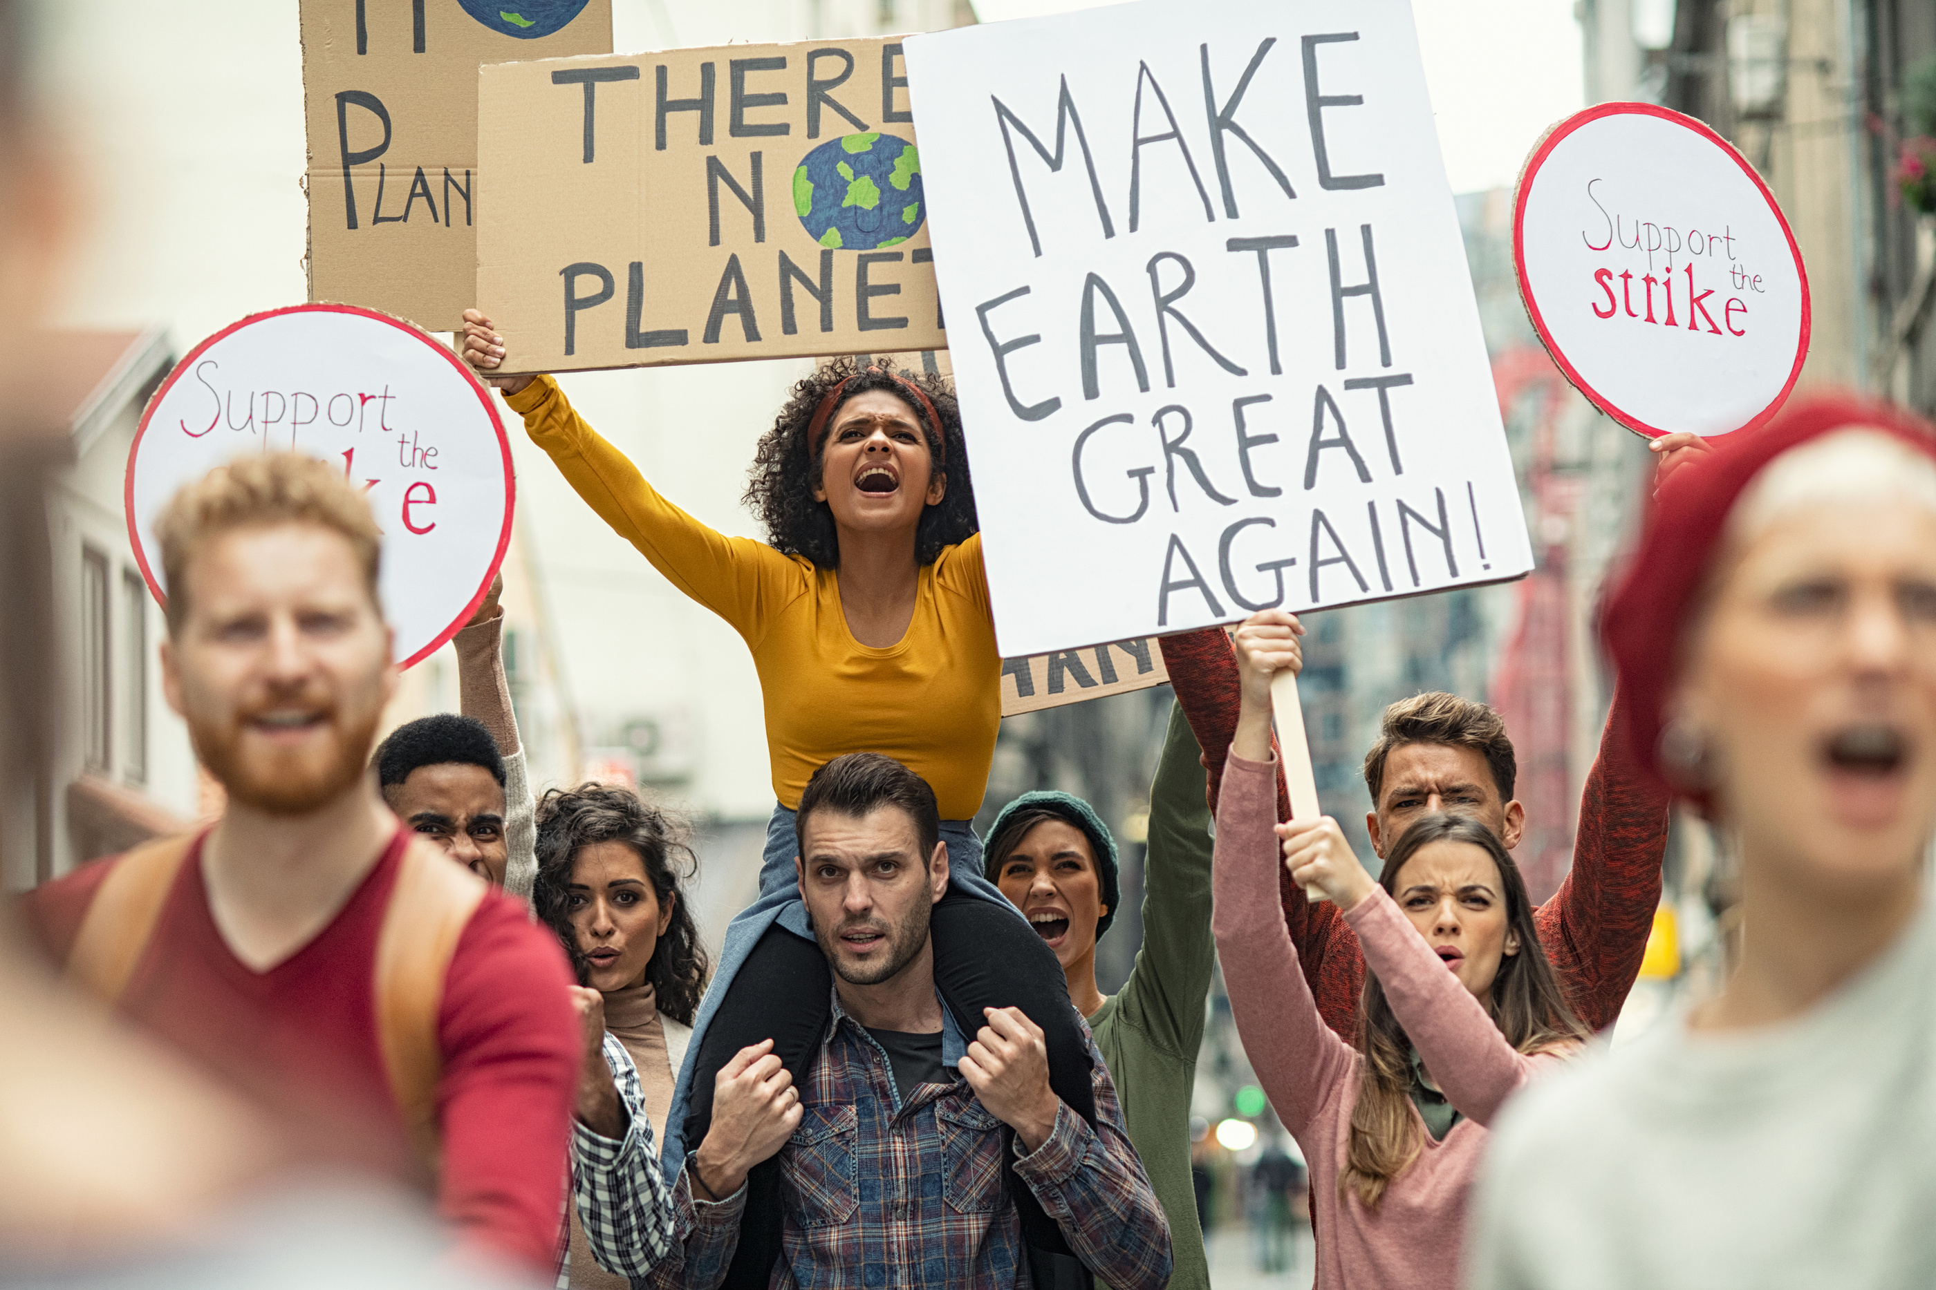
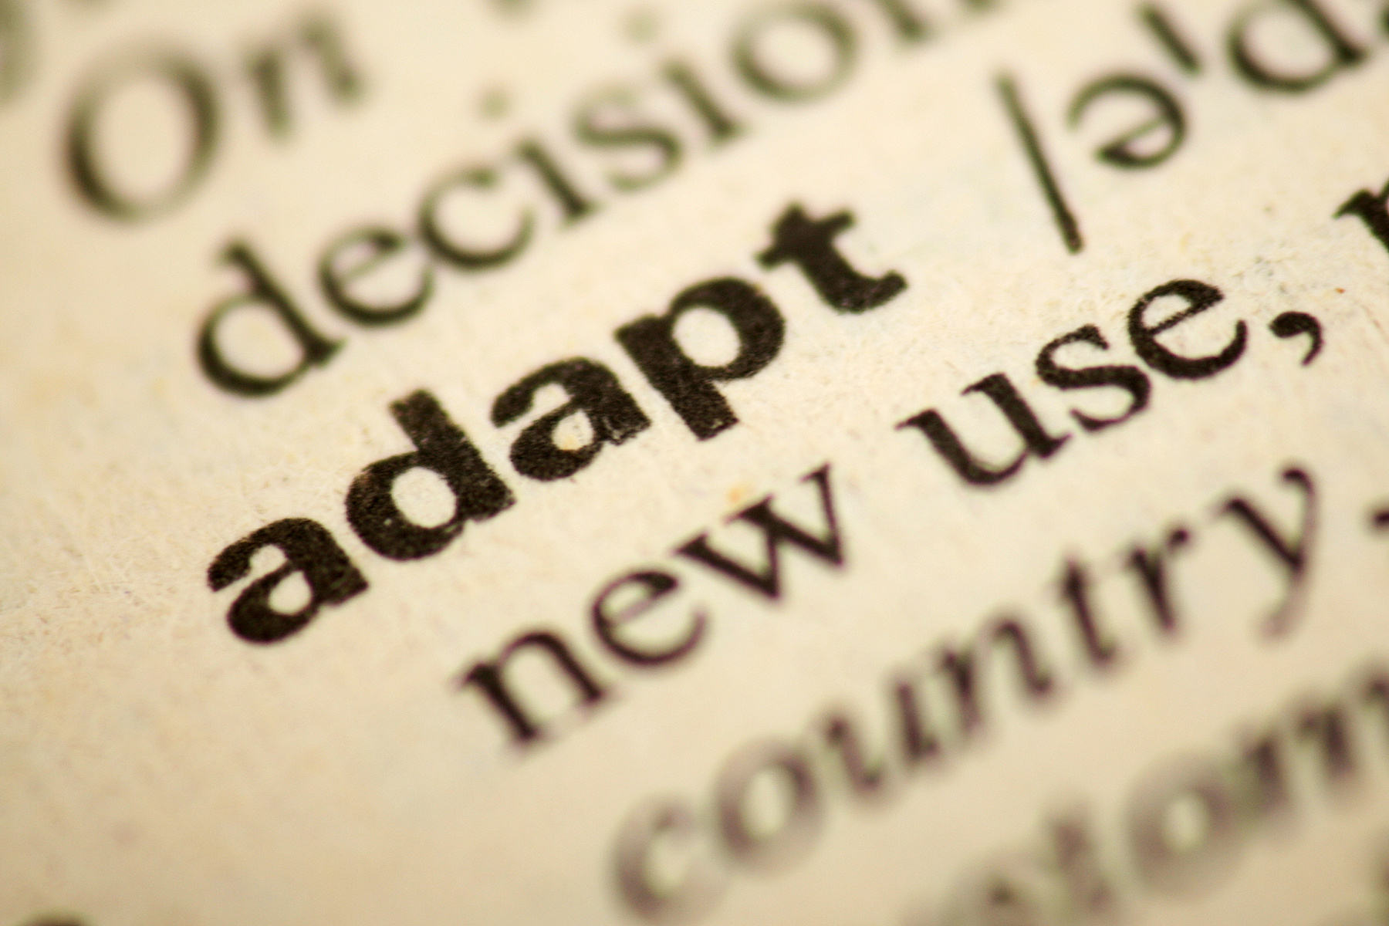

AWARENESS
ADVOCATE
ADAPT

Slide 16
SOURCE: OCHA Services | reliefweb website
(reliefweb.int) 2022
60%
40%
People that had not heard of and did not feel well-informed about climate change
People that had heard a lot or
felt “extremely well-informed” about it

Slide 17
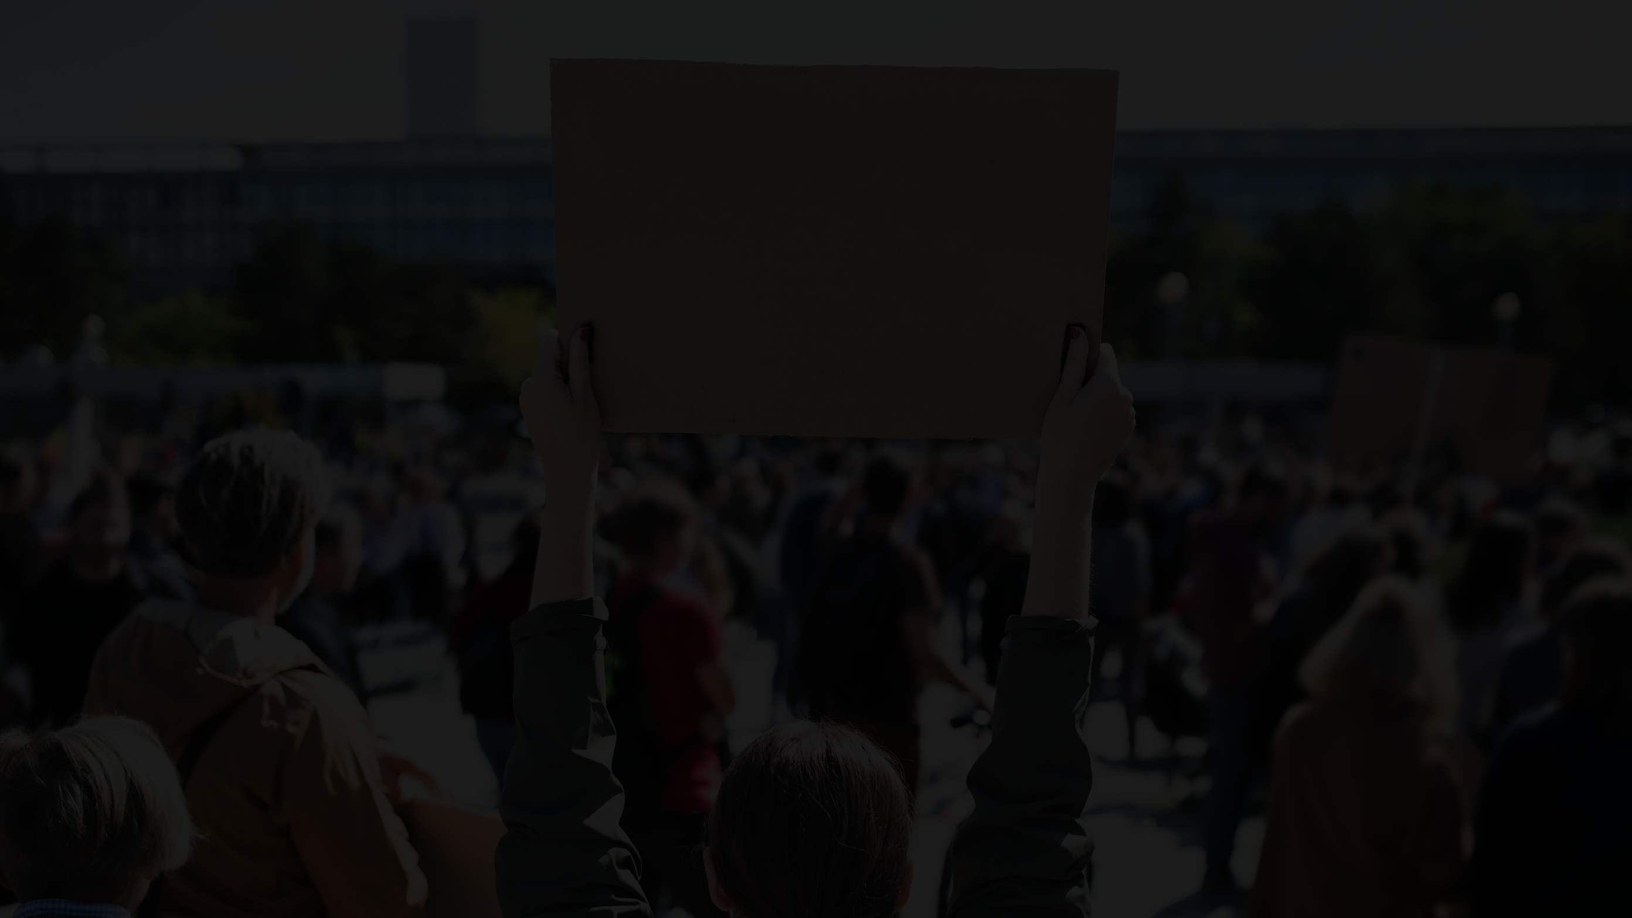
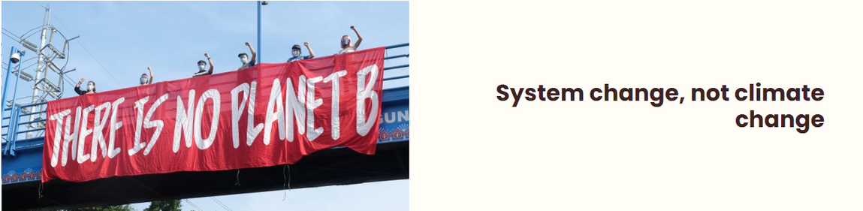
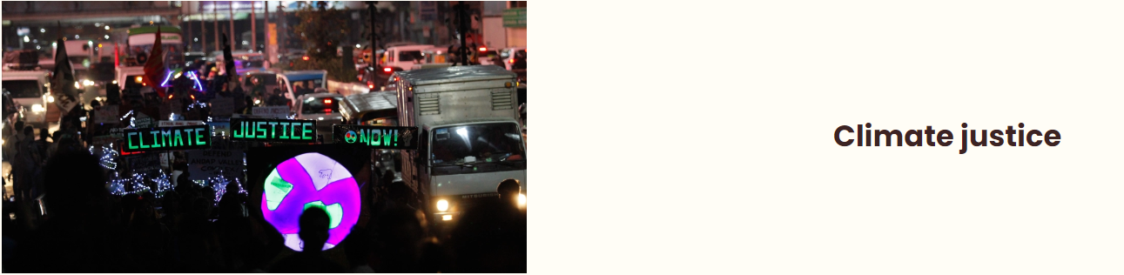
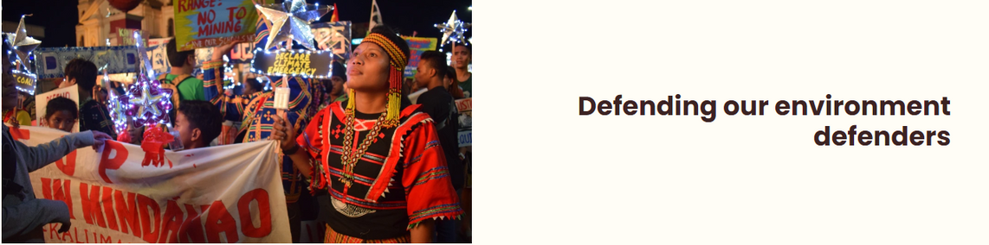
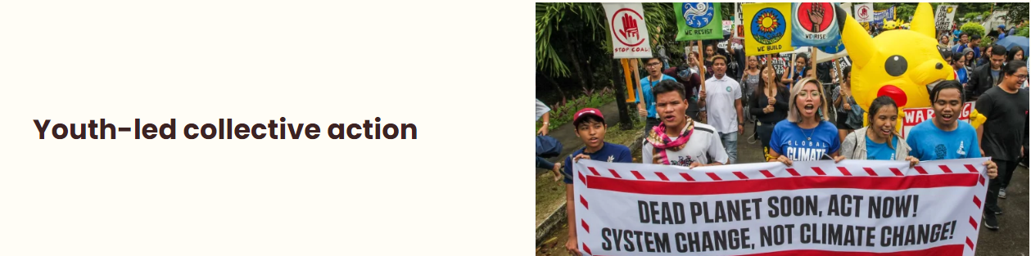
Youth Advocates for Climate Action Philippines
System change,
not climate change
Climate justine
Defending our environment defenders
Youth-led collective action
SOURCE: YACAP (yacap.org)

Slide 18


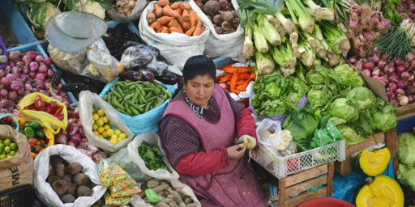
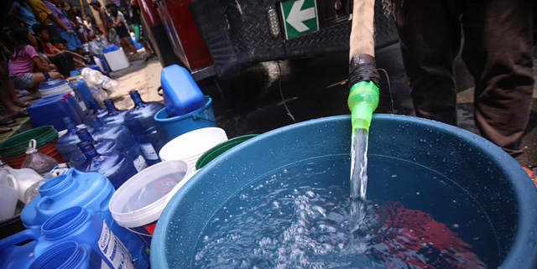
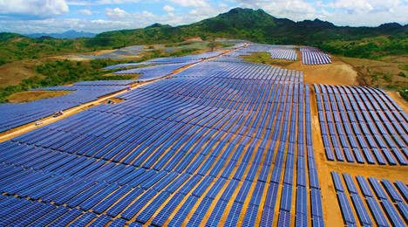

National Climate Change Action Plan (NCCAP)

Slide 19

“We can't save the world by playing by the rules, because the rules have to be changed.
Everything needs to change - and it has to start today."
-GRETA THUMBERG
THANK YOU
for watching

